Slide 1

Tata Power Analysis
Fundamental and Technical Analysis

Slide 2
About the Company
Tata Power Company Limited is an Indian electric utility company based in Mumbai, Maharashtra, India and is part of the Tata Group.
The core business of the company is to generate, transmit and distribute electricity. With an installed electricity generation capacity of 10,577 MW, it is India's largest integrated power company.
Tata Power has been ranked 3rd in 2017 Responsible Business Rankings developed by IIM Udaipur. In February 2017, Tata Power became the first Indian company to ship over 1 GW solar modules.

Slide 3
Mission and vision of the company
The company’s aim is To be the most admired and responsible Integrated Power Company with international footprint, delivering sustainable value to all stakeholders by-
Executing projects safely, with predictable benchmark quality, cost and time
Growing the Tata Power businesses, be it across the value chain or across geographies, and also in allied or new businesses.
Driving Organizational Transformation that have the conviction and capabilities to deliver on their strategic intent

Slide 4
Future prospect of the company
The company plans to take its renewable production to massive 15 GW by 2025.
Renewable power currently accounts for 30% of total capacity, while the target is to take renewable capacity to 80% by 2030.
Also, recent orders and deals bagged by Tata Power in the solar power segment has pumped up the stock.
Recently, Tata Power Solar, a subsidiary of Tata Power, has secured orders to install 100 megawatt (MW) of distributed generation (DG) capacity in Maharashtra on behalf of state-run energy efficiency services (EESL).

Slide 5
Fundamental analysis
Fundamental analysis (FA) is a method of measuring a security’s intrinsic value by examining related economic and financial factors. Fundamental analysts study anything that can affect the security's value, from macroeconomic factors such as the state of the economy and industry conditions to microeconomic factors like the effectiveness of the company's management.
The end goal is to arrive at a number that an investor can compare with a security's current price in order to see whether the security is undervalued or overvalued.

Slide 6
Current ratio (current assets/current liability)
2018-19 | 2019-20 | 2020-21
0.55 | 0.51 | 0.5
The current ratio has been decreasing.
It is also not satisfactory since the ideal current ratio is 2:1.
Current ratio is measured to find the short term financial soundness of the company.

Slide 7
Quick ratio (quick assets/current liability)
2018-19 | 2019-20 | 2020-21
0.51 | 0.45 | 0.44
The quick ratio is not ideal.
It will not be easy for the company to pay off its short term borrowings.
The quick ratio is measured to take only highly liquid assets into consideration in order to pay off debts.

Slide 8
Debt to Equity ratio (Debt/ equity)
2018-19 | 2019-20 | 2020-21
1.09 | 1.17 | 1.11
The company has an ideal debt to equity ratio.
This guarantees financial soundness to the lenders.
Debt to equity ratio is used to find the long term financial soundness of the company.

Slide 9
Total Assets to Debt Ratio (Total Assets/ Debt)
2018-19 | 2019-20 | 2020-21
4.26309994 | 3.743756587 | 3.192000685
The company has managed to reduce its assets to debt ratio.
This is important because they are trying to reducing the financing of its assets through debt.
Total Assets to Debt ratio tells how the assets of the company are financed-through equity or debt.

Slide 10
Proprietary Ratio (Equity/Total Assets)
2018-19 | 2019-20 | 2020-21
0.3720927305 | 0.3658494894 | 0.3937245955
The company has a lower proprietary ratio.
This will result in unwillingness among the creditors to lend more to the company.
Proprietary ratio is used to measure the financing of assets.

Slide 11
Interest Coverage Ratio (PBIT/ Interest on long term debt)
2018-19 | 2019-20 | 2020-21
1.085851319 | 1.210947931 | 1.066832918
This means that the company has equal earnings to interest payable.
Even a small fluctuation in the earnings can lead to interest default of the company.
This ratio measures the ability of the firm to pay off its interests through its earnings.

Slide 12
Inventory turnover ratio (Cost of revenue from operations/ Average inventory)
2018-19 | 2019-20 | 2020-21
14.25 | 12.17 | 9.76
The company has maintained a well inventory turnover ratio, which is profitable for the company.
Inventory turnover ratio measures how fast the inventory is moving, thus generating sales.

Slide 13
Working capital turnover ratio (Revenue from operations/ working capital)
2018-19 | 2019-20 | 2020-21
(Negative) | (negative) | (Negative)
Here the working capital of the company is coming out to be negative, which makes the working capital ratio negative.
This ratio shows the use of working capital in terms of carrying the business.

Slide 14
Gross profit ratio (Gross profit X100 /Revenue from operations)
2018-19 | 2019-20 | 2020-21
17.17% | 20.42% | 15.34%
As compared to the energy sector, the company is offering lower gross profit margin, with the industry average of 48.95% for the year 21.
Gross profit ratio shows the gross profit earned by the company as a percentage of its sales.

Slide 15
Operating ratio (Operating cost x 100/ Revenue from operations)
2018-19 | 2019-20 | 2020-21
84.83% | 81.31% | 86.82%
The company has managed to keep its operating margin not too high in order to give good returns
Operating ratio is used to find the operational efficiency of the business.

Slide 16
Operating profit Ratio (Operating profit x100/ Revenue from operations)
2018-19 | 2019-20 | 2020-21
15.17% | 18.69% | 13.18%
The operating profit margin has proven to be quite good for the company.
Operating profit ratio measures the operational efficiency of the business and management.

Slide 17
Net Profit Ratio (Net profit after tax x100/ Revenue from operations)
2018-19 | 2019-20 | 2020-21
21.42% | 1.91% | 14.9%
The company has performed well in the net profit factor.
It was able to give more profits than the industry average of 9.6%.
Net profit ratio is an indicator of the profitability of the business.

Slide 18
Return on Capital Employed (PBITD x100/ Capital Employed)
2018-19 | 2019-20 | 2020-21
11.09% | 10.82% | 7.41%
The return on capital employed has been reducing.
It is not a good result since the company is not able to provide more than 15% average return.
Return on capital employed is a measure of how efficiently the firms able to use its resources.

Slide 19
Technical analysis
Technical analysis may be a commercialism discipline utilized to gauge investments and establish commercialism opportunities by analyzing applied mathematics trends gathered from commercialism activity, like worth movement and volume.
Technical analysis is usually accustomed to generate short commercialism signals from varied charting tools, however may facilitate the analysis of a security's strength or weakness relative to the broader market or one among its sectors.
This data helps analysts improve their overall valuation estimate.

Slide 20
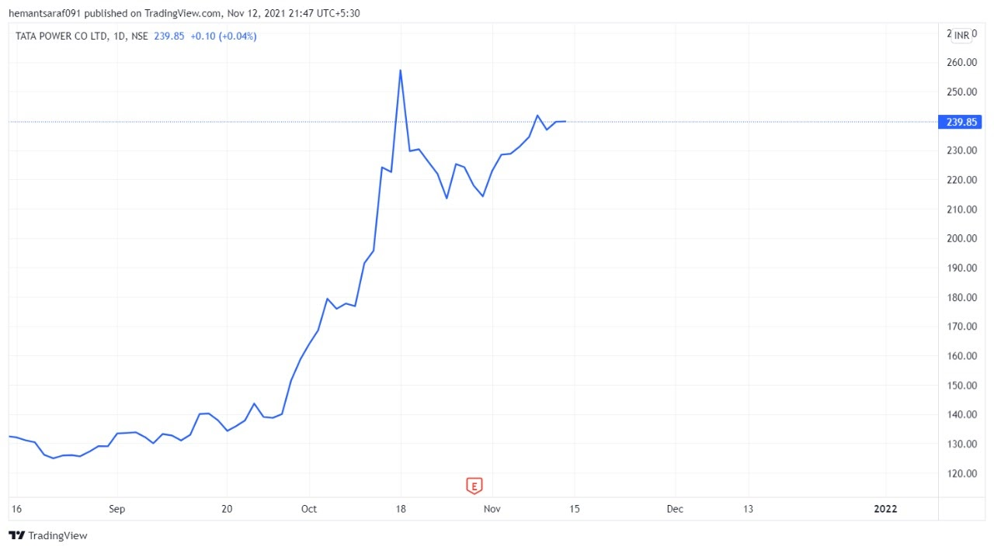
A line Chart
A line chart is a way of visually representing a company's price history using a single, continuous line. A line chart is easy to understand and simple in form, typically only depicting changes in a share's closing price over time.
Although a line chart is simple, it excludes information that other types of charts provide, such as a stock’s opening, high and low price each period. It therefore doesn’t show a stock’s price movements between closing prices.

Slide 21
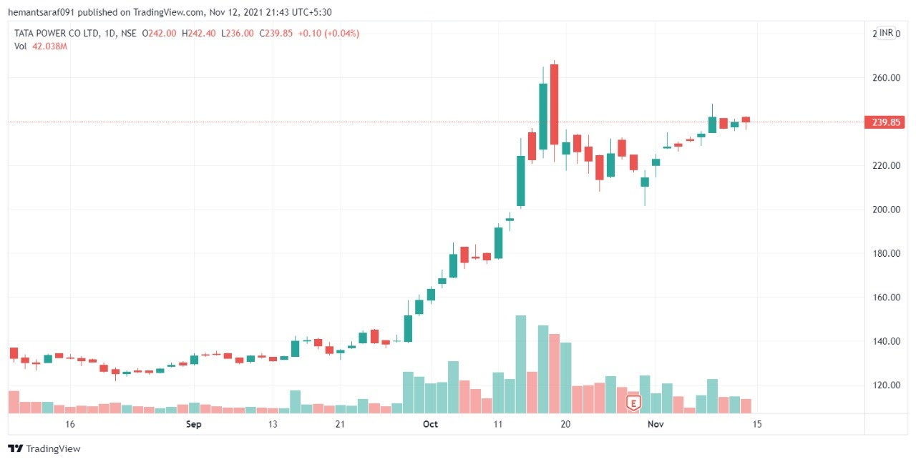
CANDLESTICK CHARTS
A candlestick chart shows four price points for each time period being displayed (e.g. daily or weekly).The four price points are: the opening price, high price, low price, and closing price.
Each candlestick is colored red or green, indicating whether the stock closed above or below its opening price.
Candlestick charts show the direction of the price and the daily performance of the stock, and traders can use this data to assess buying or selling pressure.

Slide 22
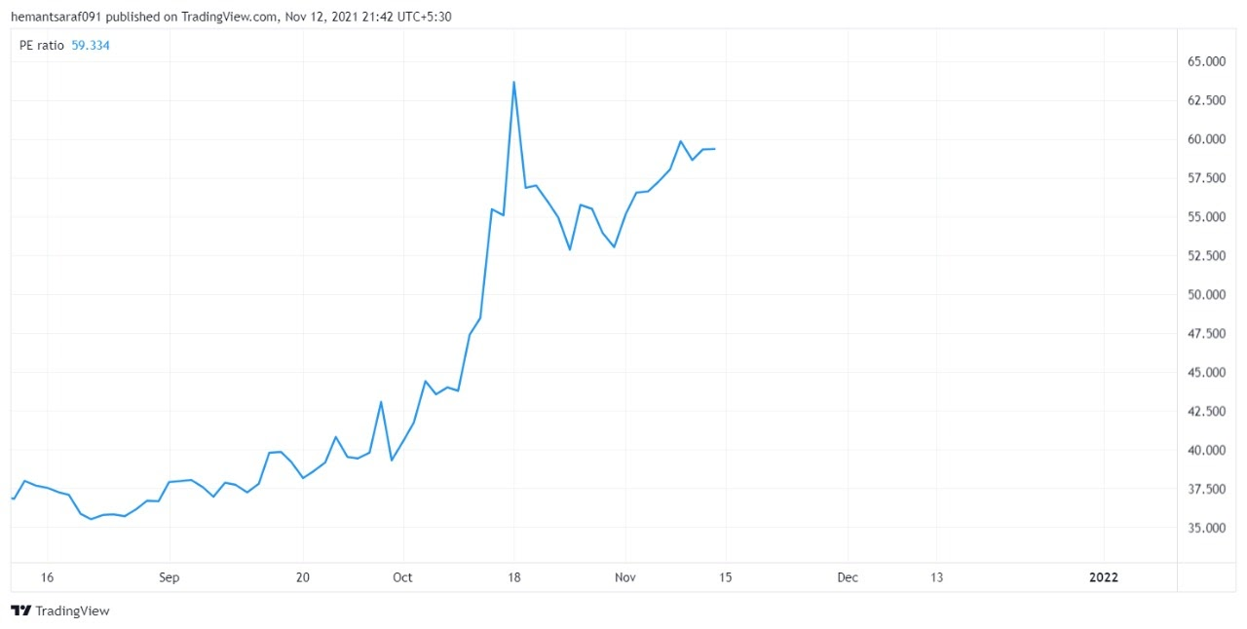
Price/Earnings Ratio (P/E Ratio)
The Price/Earnings Ratio (P/E Ratio) is an indicator that plots a company's share price divided by the earnings per share (EPS).
It is a popular measure that can be used to see if a stock is fairly valued, overvalued or undervalued. A general interpretation is that a company with a high P/E Ratio is expected to have higher earnings growth in the future.

Slide 23
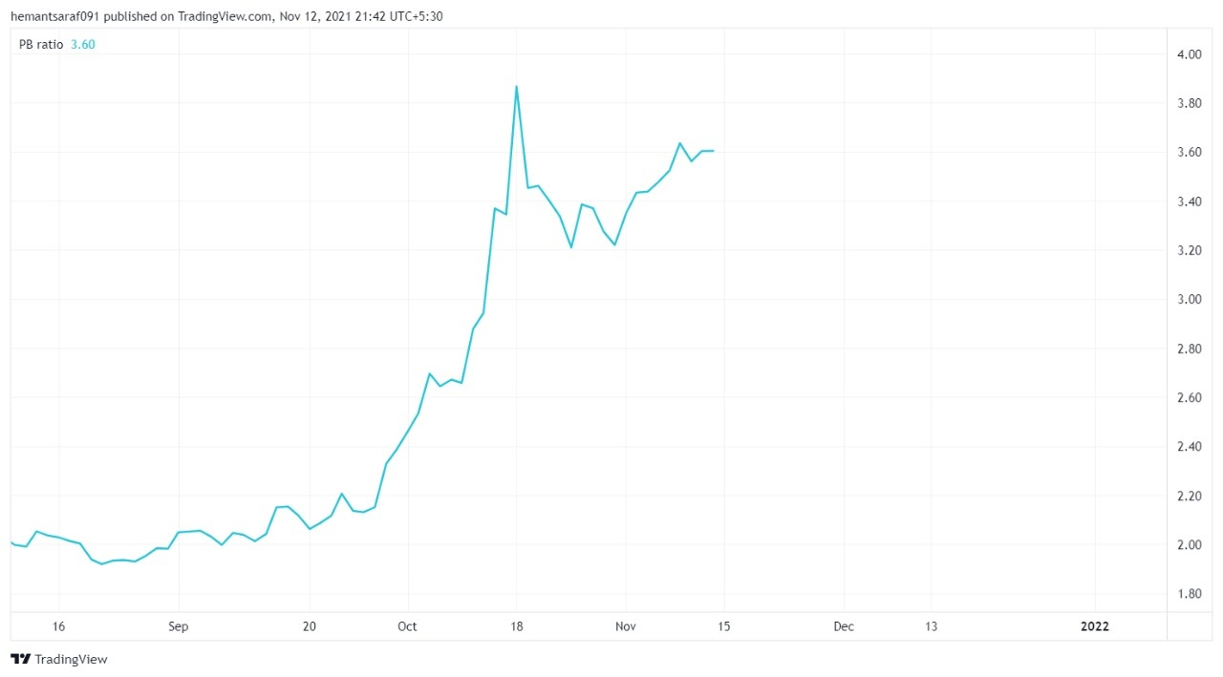
Price-To-Book (P/B Ratio)
Companies use the price-to-book ratio (P/B ratio) to compare a firm's market capitalization to its book value. It's calculated by dividing the company's stock price per share by its book value per share.
An asset's book value is equal to its carrying value on the balance sheet, and companies calculate it netting the asset against its accumulated depreciation.

